Slide 1
Health Monitoring Index – HoMie
Md. Rifat Ahmed ID # 1931725042
Fardin Bin Islam ID # 1721588642
Md Sadman Shouviq ID # 1722149042
Rafiad Rahman Badhon ID # 1722044642

Slide 2
What Is “Homie”?
“HoMie” is a health index monitoring app
Developed for Android Platform
It lets people keep records of various medical reports
It has Downloading feature for the records in the database
Reason behind the Name?

Slide 3
Why Do we need it?
The absence of data on patient information
Giving a rough idea of what and when individuals have been through an ailment leads to misdiagnosis mainly
Misdiagnosis results from not being able to access previous medical records
The primary feature of “HoMie” is monitoring the health index
With “HoMie”, people can keep track of their various health factors
Easy access to healthcare-related things

Slide 4
Literature Survey
In [1], A. N. A. Yusuf et al,
Developed a monitoring system using RUP framework to create an Android application
The three primary actors, i.e., patients, doctors, and health staff, are connected to the database through an API
Followed the black box evaluation process to test out the application
In [2], A. N. N. Chamim et al,
Developed a health care system using the Android platform
Demonstrated how Bluetooth was utilized as a conduit between the app and the Arduino to keep track of the outcomes
Measured the body temperature and heart rate with 98.45% and 95.67% accuracy, respectively

Slide 5
Literature Survey
In [4], J. Torous et al,
Created LAMP, an acronym for the words "Learn," "Assess," "Manage," and "Prevent."
A transparent system where patients had complete control of their data, which was data-driven, and built for the community based on their feedback
In [6], X. Kong et al,
Gave designation of a wireless communications system that uses medical sensor detection technology
Also a wireless communication technology to enable remote medical monitoring of various physiological parameters
The central server is in charge of maintaining the patient's medical records and offering the system's other subsystems a data-sharing service

Slide 6
Methodology
Front-end Design
Flutter was used as the framework for this system
Flutter comes with pre-built widgets that can be modified according to the developers needs
Used Figma for the initial UI designing of the system
Implemented the UI built on Figma using pre-built widgets on Flutter
Finally dynamic systems were used to handle overflow
SVG files added for frames and making the whole app look more clean

Slide 7
Methodology
Back-end Design
Back-end design was implemented using various Flutter packages
“url_launcher” package for fetching articles from sites, “flutter_svg” for banners and framing design, “flutter_spinkit” for loading animations, “flutter_phone_direct_caller” to allow direct calls, “path_provider ” to access file directory, and “syncfusion_flutter_pdf” to generate pdf files
The “google_maps_flutter” package was used to allow the use of Google Maps API key for location and navigation
Several firebase-related packages used for authentication and data entries.
Data in the database entered in the JSON format

Slide 8
Methodology
Database Management
For the database management the Firebase system was implemented.
Firebase uses a NoSQL database and stores data as JSON which allows the data to be secure as well as updated in real-time
Real-time Database Data Sync by Firebase replaces standard HTTP queries.
The Real-time Database SDK for Firebase maintains data on disk to ensure the app is responsive even when the user is offline
Upon reconnecting, the client computer retrieves any missing updates and synchronizes them

Slide 9
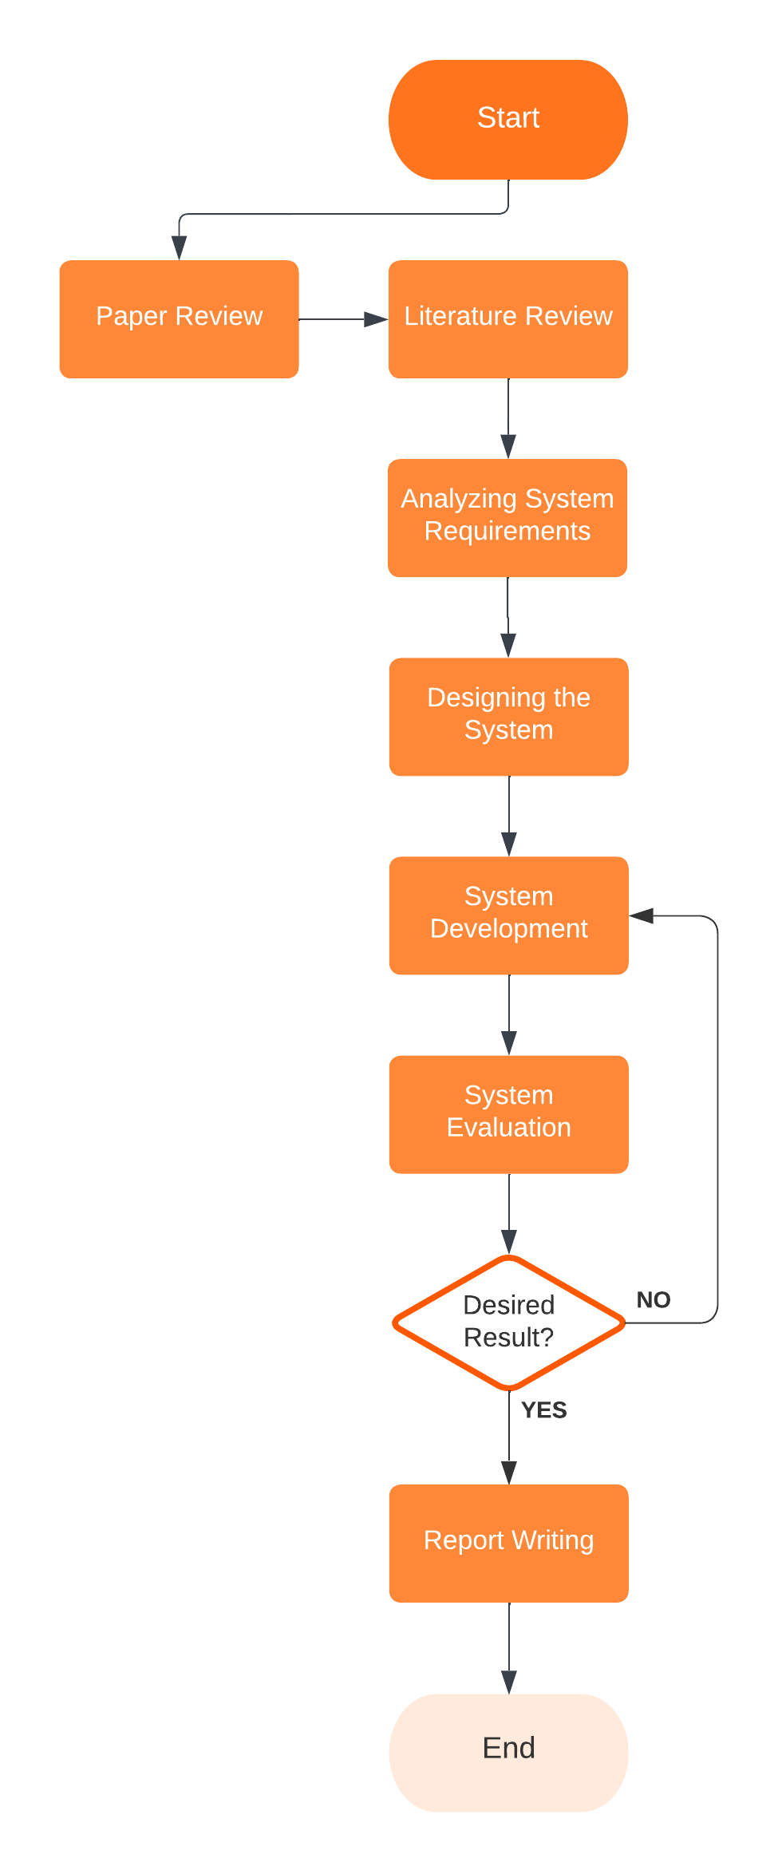
Methodology

Slide 10
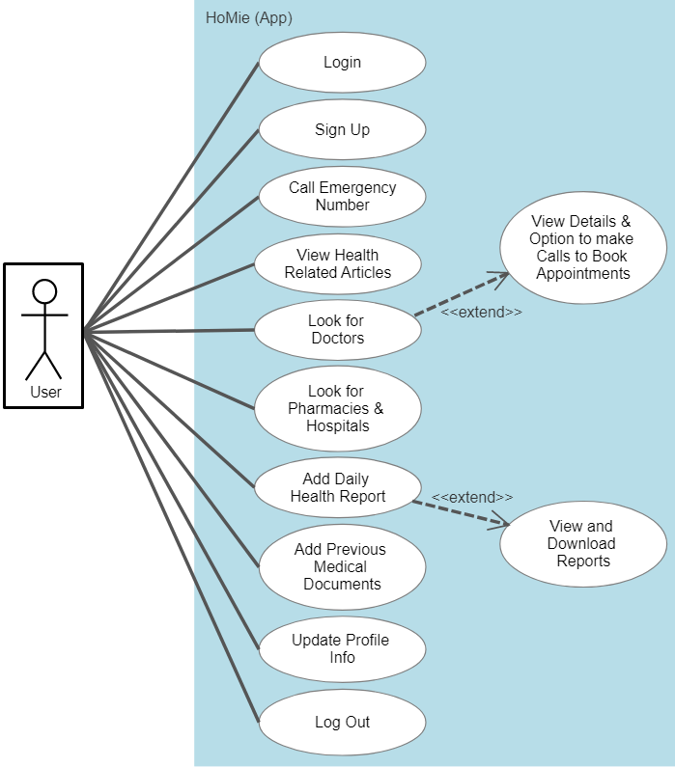
Methodology

Slide 11
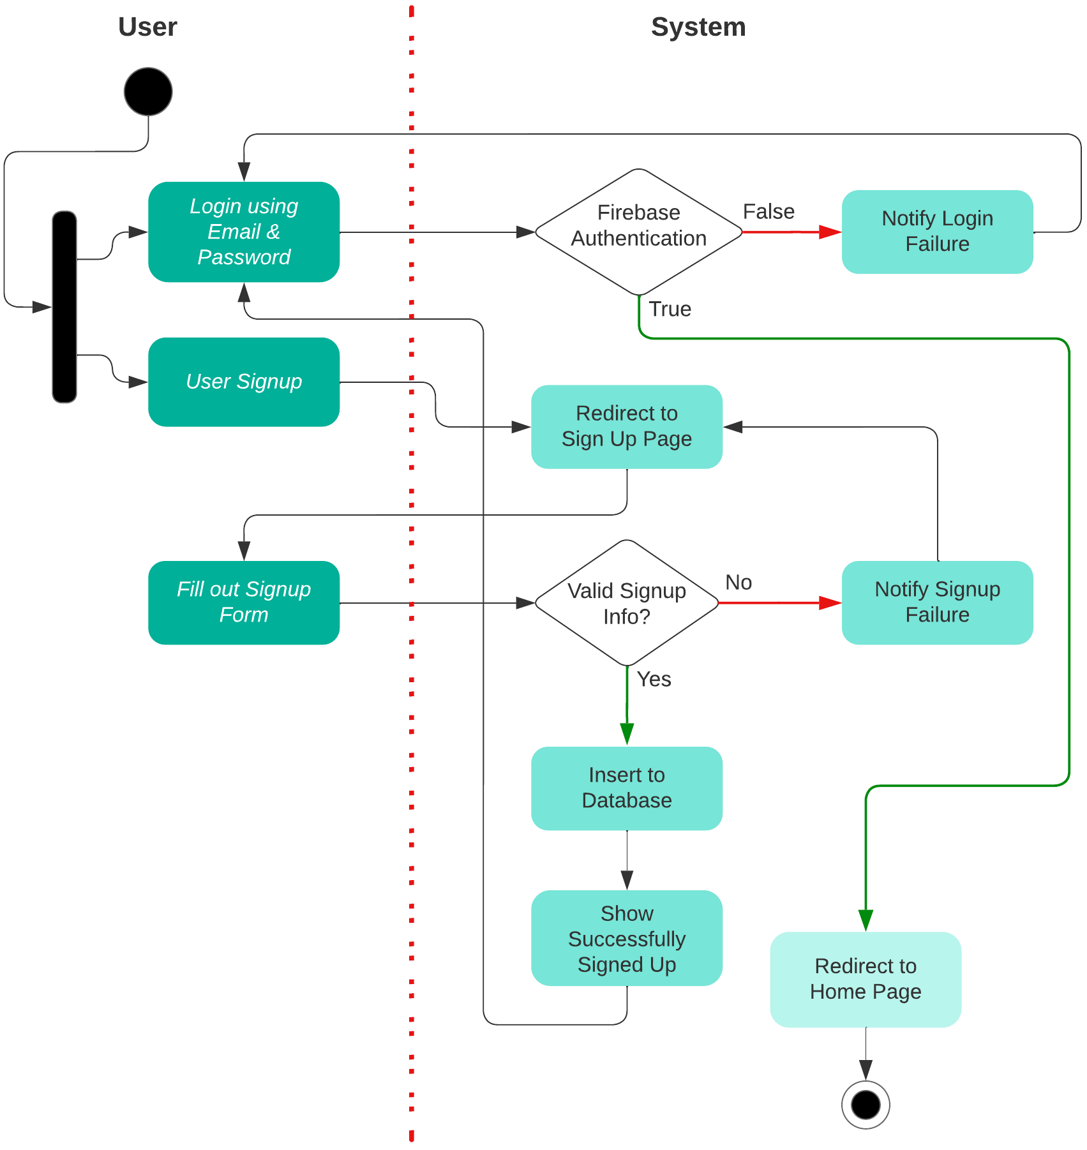
Methodology

Slide 12
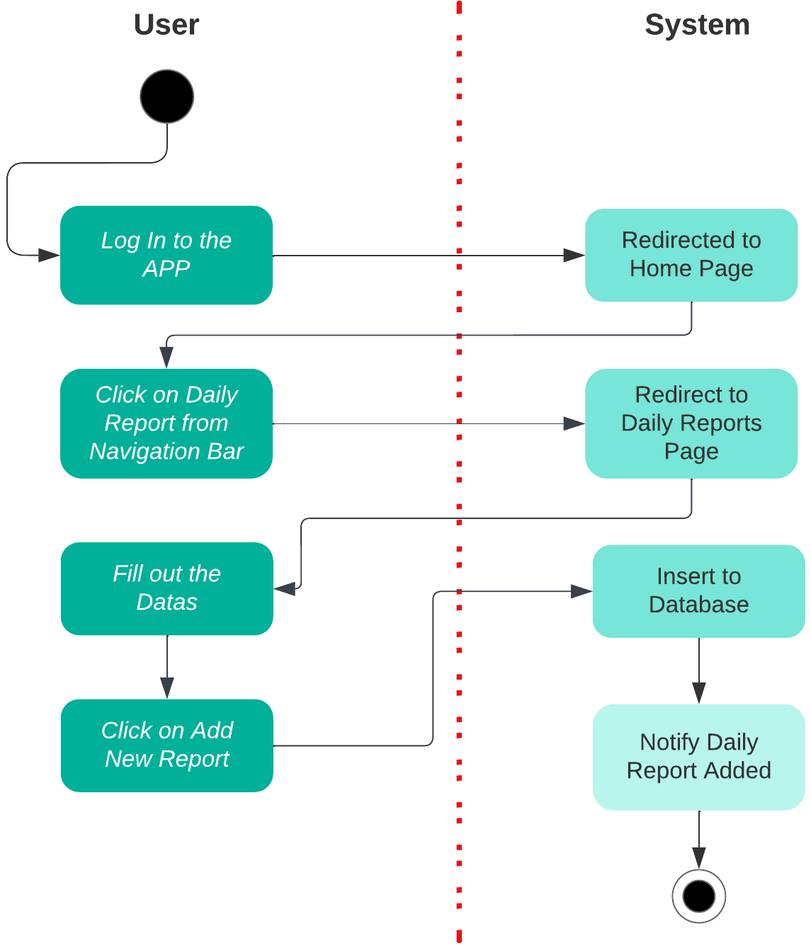
Methodology

Slide 13
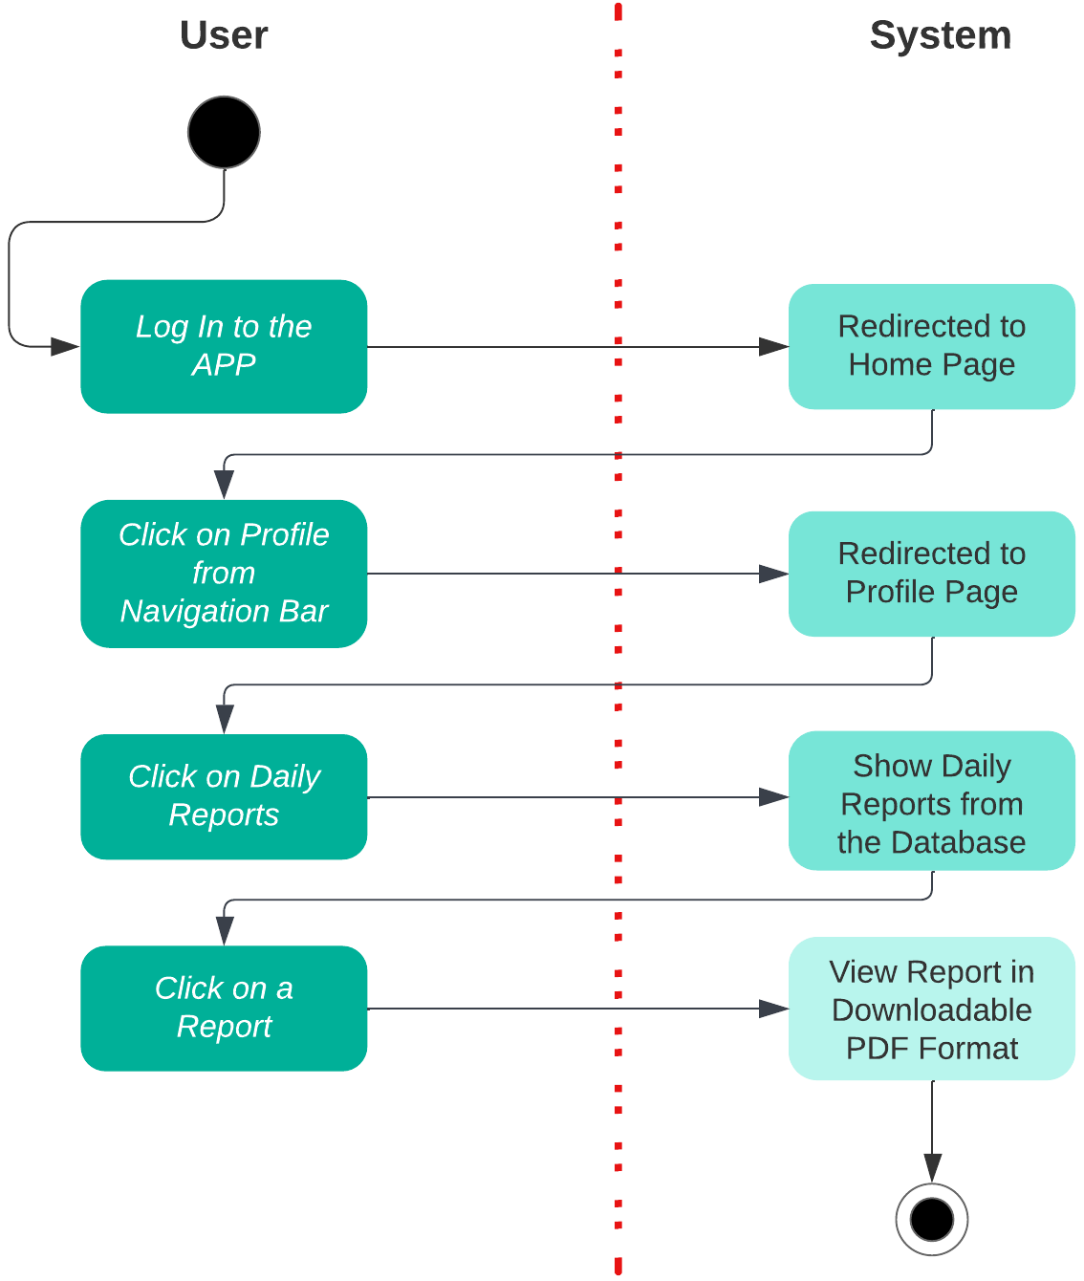
Methodology

Slide 14
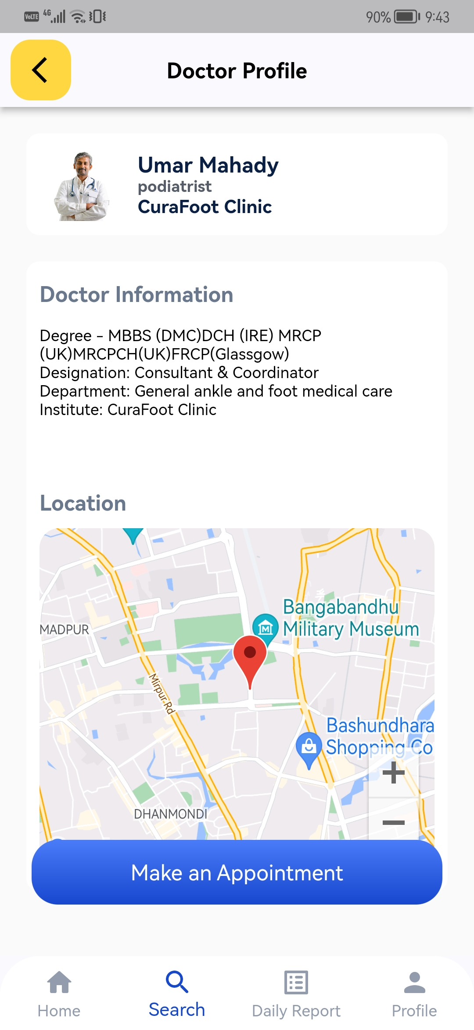
Results and discussions
Evaluated using black box testing method
Aspects such as multiple account creation from one email and fake login credentials being tested
The Firebase Authentication system allows the login system to function properly
On the homepage the emergency call function needed to be tested and as expected it first asked permission to make calls and then made the call
Clicking on articles properly redirected to the article site, which concluded proper functioning of the API
In the doctors profiles their information were properly showing and the Google Maps API properly showed the location of the doctor on the maps

Slide 15
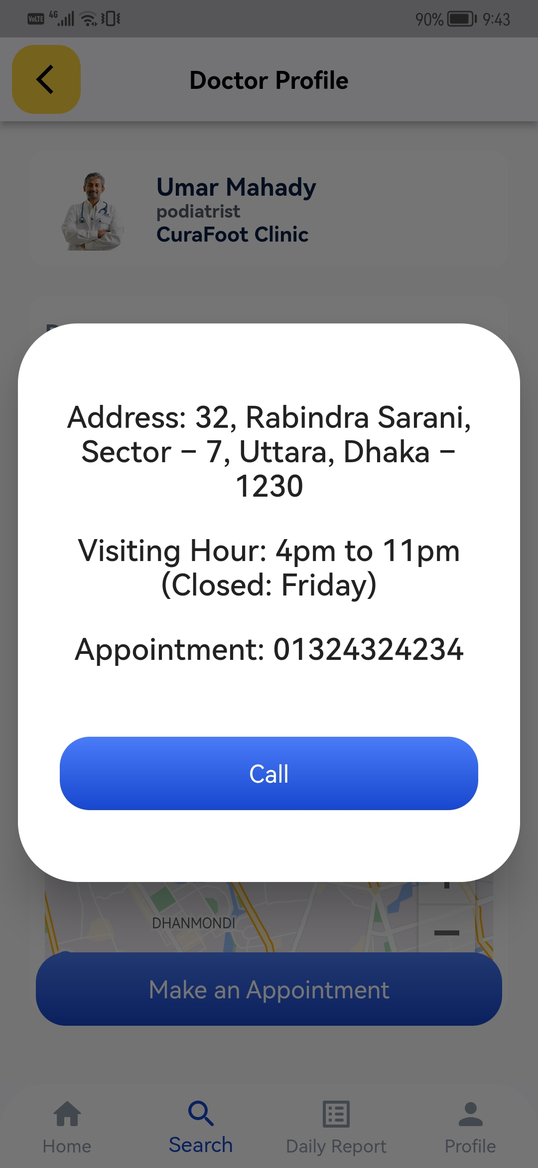
Results and discussions
Once the “Make and Appointment” button was triggered a pop-up with the desired doctors number comes up to prompt making calls
Once reports are added a notification is shown that they have been added successfully
The said reports could be viewed on the “Daily Reports” tab on Profiles page
After opening the reports an option to download the reports was present
The system properly retrieved user data from the database and showed them in the desired format

Slide 16
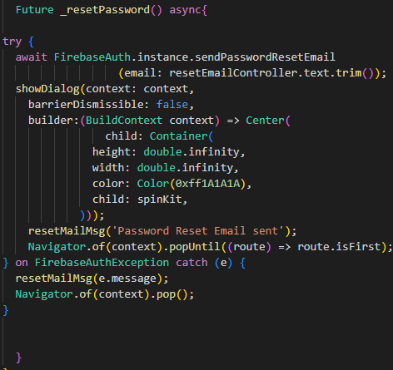
Results and discussions
The reset password option sends an email to the users email address
Previous medical reports could be added successfully from the file manager and viewed
The logout option also performed without hiccups and logged users out properly
Overall, a total of 15 test cases were tested and all returned favorable outcomes

Slide 17
Conclusion
Not keeping track of personal health conditions leads to misdiagnosis
Our primary purpose is to enable the ability to store and download data on the users' health conditions
Users can also learn about various health-related topics, search for doctors, pharmacies, or hospitals, and even book appointment

Slide 18
Future plans
We plan on implementing a messaging feature between the users
Reviewing the doctors feature
Plan on making the front end even more user-friendly
Work on the back-end for better database management

Slide 19
References
[1] A. N. A. Yusuf, F. Y. Zulkifli, and I. W. Mustika, "Development of Monitoring and Health Service Information System to Support Smart Health on Android Platform," International Conference on Nano Electronics Research and Education (ICNERE), pp. 1-6, 2018.
[2] A. N. N. Chamim, J. Rinaldi, Y. Ardiyanto, I. Iswanto, and A. Ma'arif, "Heart Rate and Body Temperature Monitoring Based on Android Operating System," International Conference on Industrial Electrical and Electronics (ICIEE), pp. 143-148, 2020.
[3] J. Torous et al., "Creating a Digital Health Smartphone App and Digital Phenotyping Platform for Mental Health and Diverse Healthcare Needs: an Interdisciplinary and Collaborative Approach," Journal of Technology in Behavioral Science, vol. 4, pp. 73-85, 2019.
[4] X. Kong, B. Fan, W. Nie and Y. Ding, "Design on mobile health service system based on Android platform," IEEE Advanced Information Management, Communicates, Electronic and Automation Control Conference (IMCEC), pp. 1683-1687, 2016.

Slide 20
Thank You

